Slide 1


Enterprise Resource Planning (ERP) Project Update: Discovery Phase
DAF and Administrator Meetings
Business & Digital Transformation Office
Fall 2025

Slide 2

Agenda
Provide a brief overview of the ERP project
Discuss the current Discovery phase
Look ahead at what is next
2
2
2

Slide 3

Business & Digital Transformation Roadmap
A multi-year initiative to modernize enterprise-wide systems, business processes, data governance, and support models we rely on to execute core administrative functions at the Institute
The goal is to enable our community to:
Spend less time transacting
Better access, understand, and utilize business data
Benefit from improved support
Some roadmap current projects underway:
a new Intranet
an artificial intelligence (AI) Administrative Chatbot
a Research End-to-End assessment
Data Governance & Data Platform related work
ERP project - the largest project on the roadmap
3

Slide 4
ERP Project Overview
The primary objective of the Enterprise Resource Planning (ERP) project is to reduce the administrative burden on the community by:
Enhancing our administrative services to better support the MIT community
Streamlining our business processes to free up time for what matters most
Modernizing and integrating our systems to create a more intuitive and connected experience
Oracle is the next generation ERP software that will replace the majority of our aging legacy systems across human resources, payroll, budgeting, finance, and research post-award, including SAP.
Huron will serve as the implementation partner to support a six-month Discovery phase to confirm key areas of scope including business processes, integrations, reports and data.

Slide 5
ERP Project Phases
The ERP project is currently planned for 36 months across the following phases:
Discovery (6 months) – includes confirmation of project scope and priorities
Implementation (30 months) – includes design, configuration, testing, training and cutover
Post Go-Live Support – begins after go-live
HR/Payroll,
Finance, Post-Award
Go-Live
Budget
Go-Live
CY2025
CY2026
CY2027
CY2028
Discovery
Implementation
Post Go-Live Support
5
5

Slide 6

What is the Discovery phase?
The Discovery phase will lay the foundation for the upcoming larger Implementation phase of the ERP project.
Goals
Define project scope
Confirm priorities
Refine our implementation strategy
Focus Areas
Scope Analysis
Chart of Accounts
Business Process Pilots
Project Management
Change Management
Integrations, Data, & Reports

Slide 7
Discovery Phase: Scope Analysis
WHAT
Key MIT-specific topics across HR/Payroll, Budget, Finance and Post-Award that need scope confirmation and prioritization
GOALS
Begin to gather requirements and understand Oracle functionality and best practices.
Gather initial community input (DAFs, Administrators, Assistant Deans, Central teams, etc.)
Confirm applications, modules, and features for the Implementation phase.
Recommendations and leadership approval on key topics targeted for end of November.
Academic/Faculty Administration
Faculty payment plan
Annual Salary Review (ASR)
Learning Management
Applicant Tracking
Leave & Absence Management
Appointment processing transactions (APR)
Organizational Hierarchy
Benefits scholarship applications
Performance Management
Buy to Pay (B2P)
Position Management
Effort Reporting
Records/Document Management
7

Slide 8
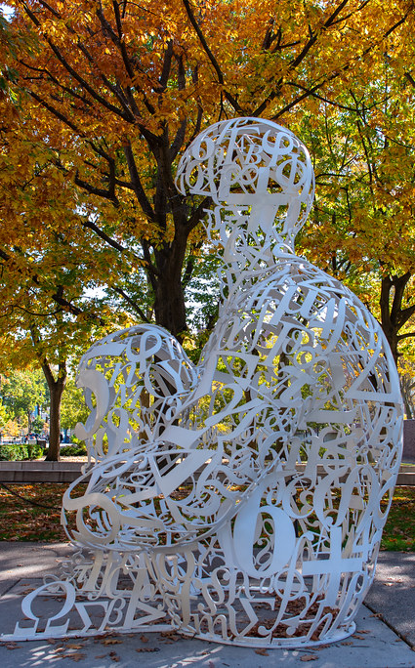
Discovery Phase: Chart of Accounts
WHAT
Chart of Accounts (COA) is the coding structure that defines an organization’s operations in financial terms (fund centers, profit centers, cost objects, etc.)
COA serves as the building block of the general ledger and financial reporting organizing business activities using codes and hierarchies to enable financial analysis and reporting.
GOALS
Organize and convene an Advisory Group and Working Group with DLCI participation.
Define current requirements leveraging Oracle’s best practices
Prototype, socialize, and confirm a future-state COA structure.
Establish a strategy for mapping legacy accounting data to the new chart structure.
Proposed chart structure targeted for end of November.
8
8

Slide 9
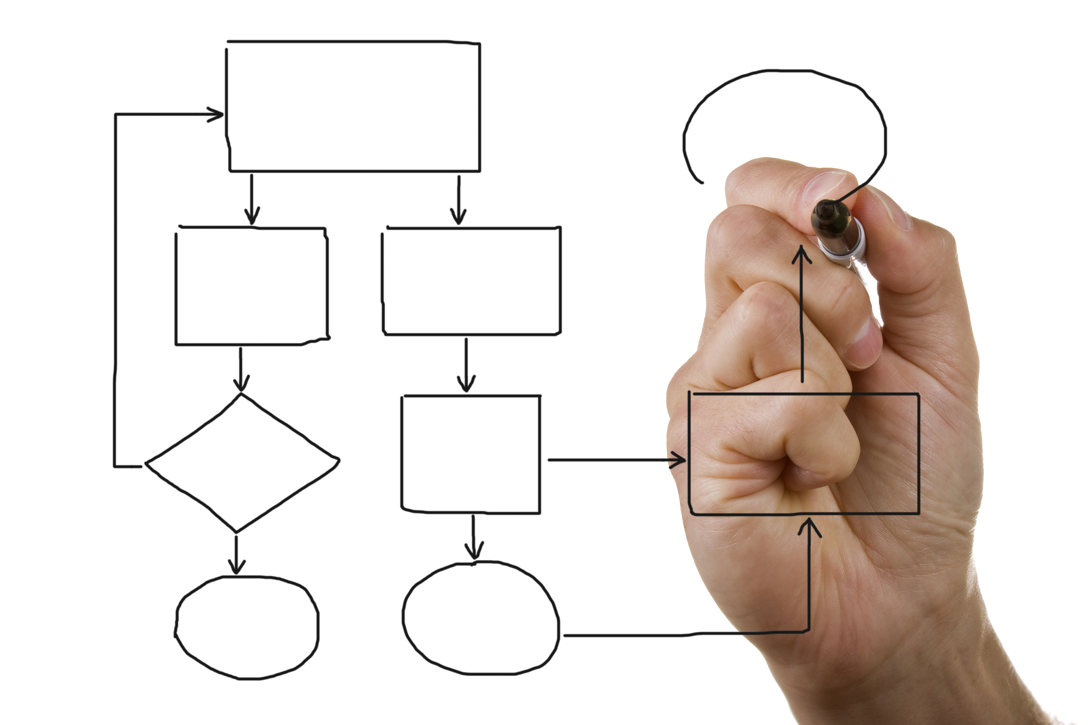
Discovery Phase: Business Process Pilots
WHAT
Conduct an “end-to-end process review” pilot for two selected business processes:
HR: Recruit to Hire
Finance: Accounts Receivable & Billing
An "end-to-end process review" involves a comprehensive examination of a process, from beginning to end, to identify areas for improvement and ensure efficiency and effectiveness.
This work will be performed on all impacted business processes during the Implementation phase with input from the community.
GOALS
Create a holistic view of how a specific outcome/goal is achieved, encompassing all departments and all activities involved.
Conduct meetings to define current state requirements and learn about Oracle and best practices.
Develop initial future-state process that includes reporting, AI/automation, and integrations.
Proposed optimized process will be finalized by end of December.
9

Slide 10

Discussion
Based on what you know to date…
What are you most excited about?
What gives you pause?
Questions or clarifications on the project overall?
10

Slide 11
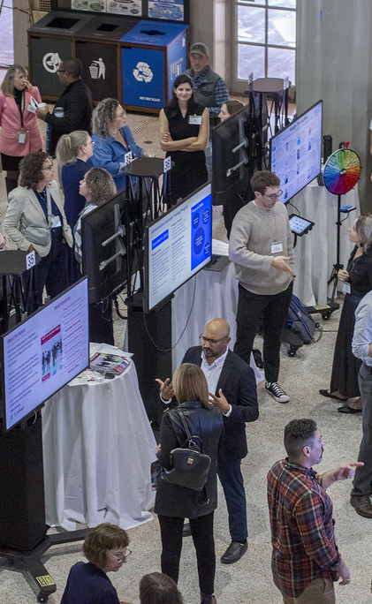
Looking Ahead
Key Takeaways
Your input and subject matter expertise is key - thank you to those participating and informing the Discovery phase so far!
The Discovery phase ends Jan. 2026.
The Implementation phase begins Feb. 2026 and will initially focus on design and configuration activities.
We will engage DAFs, Administrators and others to participate and provide feedback.
An ERP project website will launch in Nov. 2025 to share information such as FAQs, glossary, and project resources.
Stay curious, share your thoughts and please ask questions!
Upcoming Events
Oct. 29: Collaborating for MIT’s Future Poster Session.
Nov. 20: Fall 2025 Admin. Staff Meeting (includes an ERP project update)
Early 2026: “ERP 101” workshop available
Feb. 5: Next ERP project update to this group
Suggestions? Questions?
Share ideas on how best to communicate with you
Email bdto@mit.edu anytime
11
11
11

Slide 12
Appendix
12

Slide 13
Scope Topic Analyses: DLCI participants
Buy To Pay (B2P)
Effort Reporting
Name | Org
Becca Bly | SA+P, Media Lab
Alexandra Cabral | SoE, Mech. Engineering
John Congdon | SHASS, MTA
Rose Durham | MIT Health
Ruth Evensen | MIT Health
Stephanie Gayle | Facilities
Nevan Hanumara | SoE, Mech. Engineering
Renee LeBlanc | SoS, Picower Institute
Lisa Lieberson | Provost, McGovern Institute
Amy Luster | Resource Development
John McDonald | DSL
Michele Miele | EHS
Tracy Nash | SCC, CSAIL
Valery Takouo Noghiessie | VPR, Koch Institute
Nathan Philips | IS&T
Brian Pretti | SoS, Chemistry
Rebecca Reid | SoS, Chemistry
Patricia Shaughnessy | Sloan
Name | Org
Gabriella Browne | Provost Office
Pam Schickling Buckley | VPF
Kimberly Croft | VPR, Cost Analysis
Lynn Hinds | VPR, HQ
Vivian Holmes | VPR, RAS
Darren Scartissi | VPF, Payroll
Amanda Tat | VPR, HQ
Robert Tolu | VPR, RAS
Leslie Wright | VPF, Payroll
Macall Zimmerman | SoE
TBD | IS&T
Next Steps:
Actively working with implementation partner to define requirements and learn about Oracle and best practices
Recommendation on high level process approach targeted for end of November
13

Slide 14
Business Process Pilots: DLCI participants
HR: Recruit to Hire pilot
Finance: Accounts Receivable & Billing pilot
Name | Org
Helene Baeyaert Kelsey | VPR, HQ
Kimberli DeMayo | SoS, Brain & Cognitive Sciences
Michele Harris | SoE
Tracie Hauge | Sloan
Catherine Kim | SoE
Anna Ludwig | SHASS
Riley Noone | SCC, CSAIL
Diane Ramirez-Riley | SCC
Irina Singh | SoE
Shannon Wagner | SoS, Dean’s Office
Lauren Weinstock | SA+P, Media Lab
Name | Org
Tyler Brezler | SoS, Biology
Matt Busekroos | SCC, CSAIL
Irina Franklin | SA+P
Cyndi Gately | Sloan
April London | SoE, SSRC
Kristen Shikes | VPR, Nuclear Reactor Lab
Next Steps:
Standing meetings underway to define current state requirements and learn about Oracle and best practices
Proposed optimized process will be finalized by end of December
14

Slide 15
Chart of Accounts: DLCI participants
Chart of Accounts Advisory Group
Chart of Accounts Working Group
Name | Org
Tia Prevett Charron | VPF
Kimberly Croft | VPF
Sean DeBoer | SHASS
Katie Hammer | VPF
Lynn Hinds | VPR
Vivian Holmes | VPR
Andrew Iannaccone | VPR
Andrei Kozhev | HR
Michael Leskiw | SMART
Marianthe Mewkill | MITIMCo
Meaghan Murray | HR
Alison Parisi | VPF
Jonathan Schwarz | IR
Mary Ellen Sinkus | Provost Office
Kari Thande | SoS
To be confirmed | LL
Name | Org
Rachel Arons | VPF
Chris Artis | OVC
Clarel AuGuste | VPF
Joe Beauregard | Sloan
Marine Brown | Facilities
Irene Huang | SoE
Janine Marchese | SA+P
Edward McDonogh | VPF
Ross Monaghan | VPF
John Parro | VPF
Melissa Sheehan | VPR
Joseph Sinischalchi | VPF
Edina Skaljiic | SCC
Next Steps:
Standing meetings underway to define current requirements and learn about Oracle and best practices
Proposed chart structure targeted for end of November
15

Slide 16
High-level ERP discovery phase timeline
July
Aug
Sept
Oct
Nov
Dec
Jan
Project Management
Establish project management framework and prepare the implementation plan
Define the approach for realizing project benefits
Change Management
Conduct stakeholder analysis and communication planning to inform the implementation change management strategy
Chart of Accounts
Prototype, socialize, and confirm a future-state Chart of Accounts structure
Establish a strategy for mapping legacy accounting data to the new Chart structure
Functional Scope & Scope Analyses
Gather community input and obtain leadership approval on foundational scope questions
Confirm applications, modules, and features to be implemented
Process Mining & Business Process Pilots
Analyze current-state processes with Celonis
Develop initial future-state process that includes reporting, AI/automation, and integrations
Technical, Data, and Reporting
Determine a preliminary integrations inventory
Define the conversions strategy and conversion object scope
Validate the reporting and analytics architecture/strategy
16

